Slide 1
TAIWANESE CREDIT CARD FAULT ANALYSIS
CREATED BY: NISHANT PORWAL

Slide 2
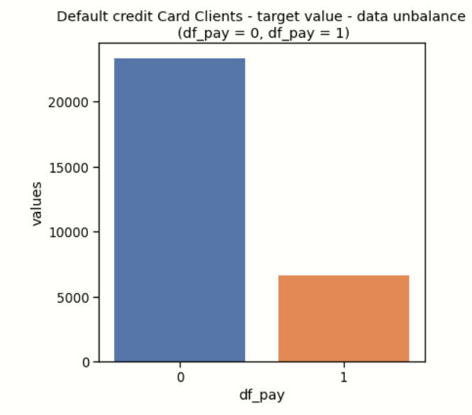
Distribution of default credit card clients
6636 people out of 30000 people will default next month, while rest are assured to pay on time.

Slide 3
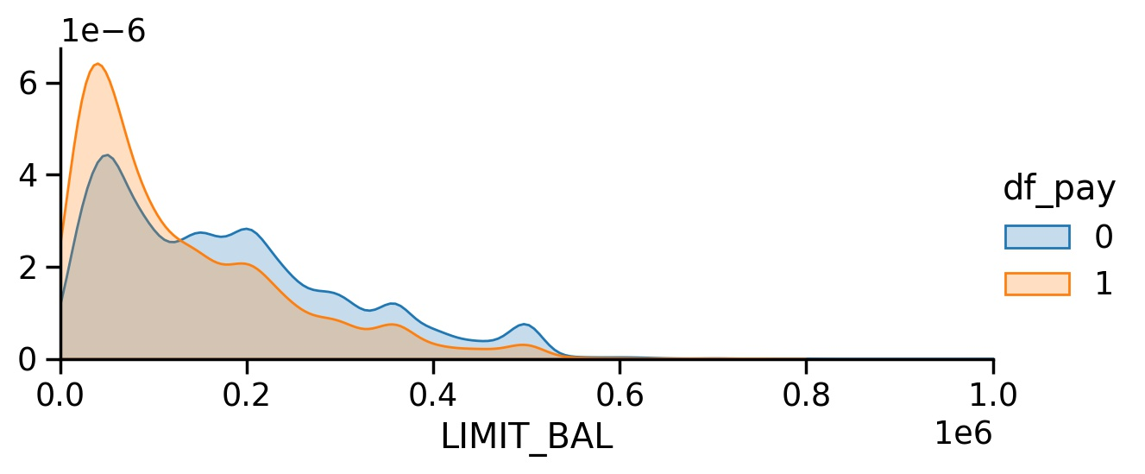
LIMIT BALANCE FREQUENCY
Potential defaulters show higher frequency of lower limit of amount of credit limit.

Slide 4
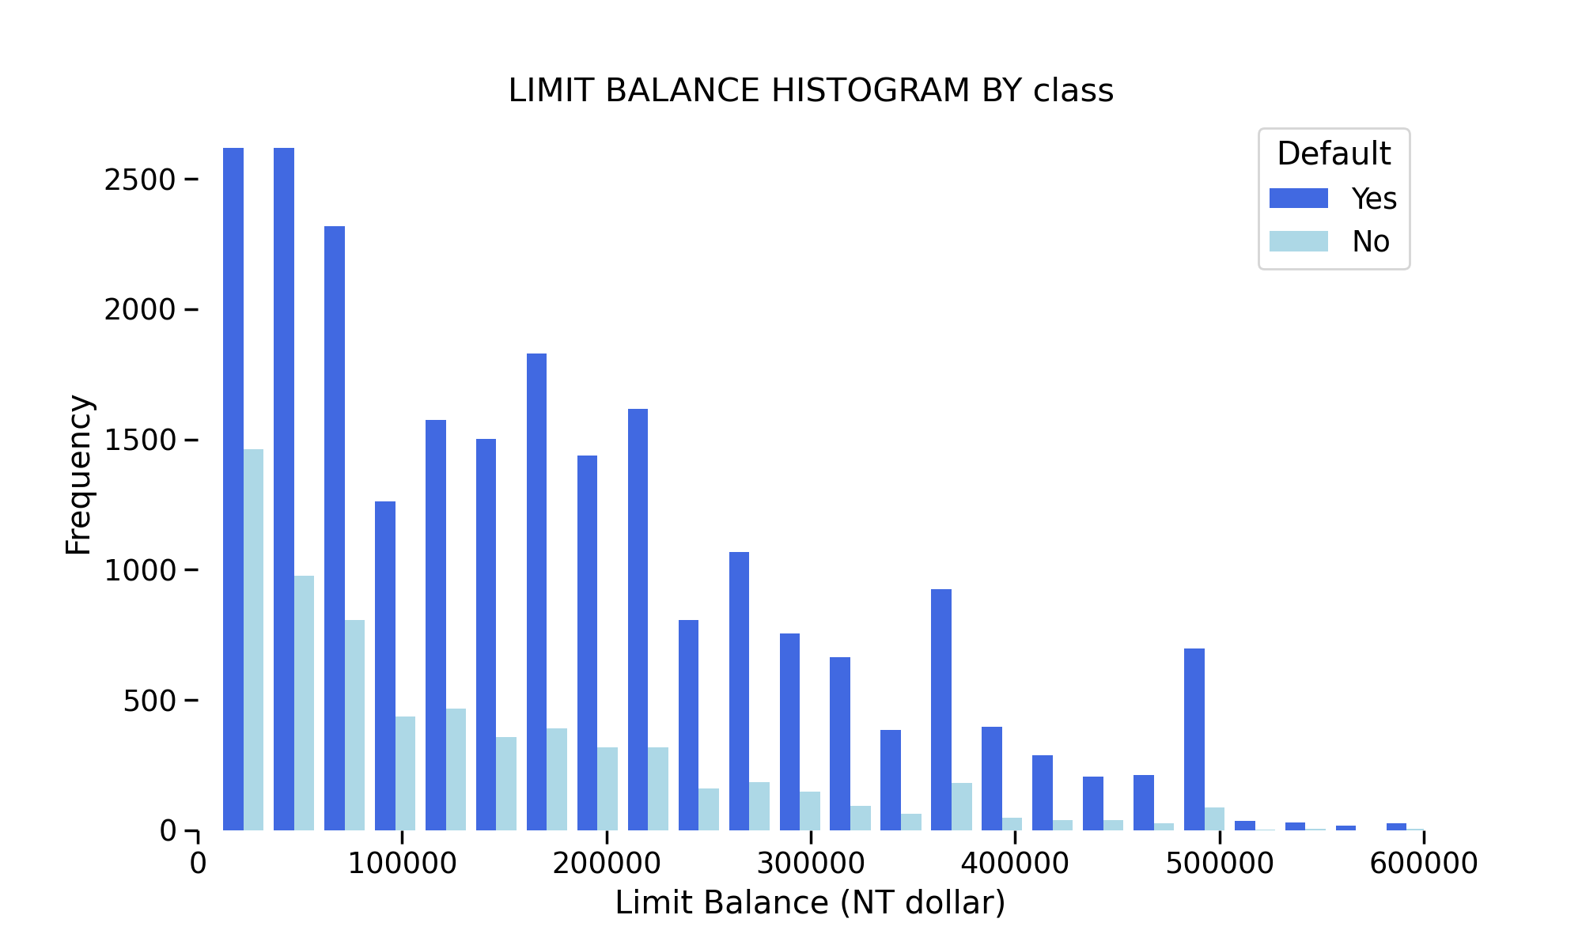
LIMIT BALANCE HISTOGRAM BY class
Overall most credit card defaults are by clients with credit limit balance up to 100,000 NT.

Slide 5
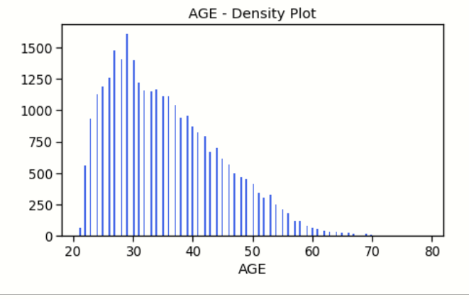
Frequency distribution of Age
Higher density of people found in age group 25 to 40. With highest density around 30 years old.

Slide 6
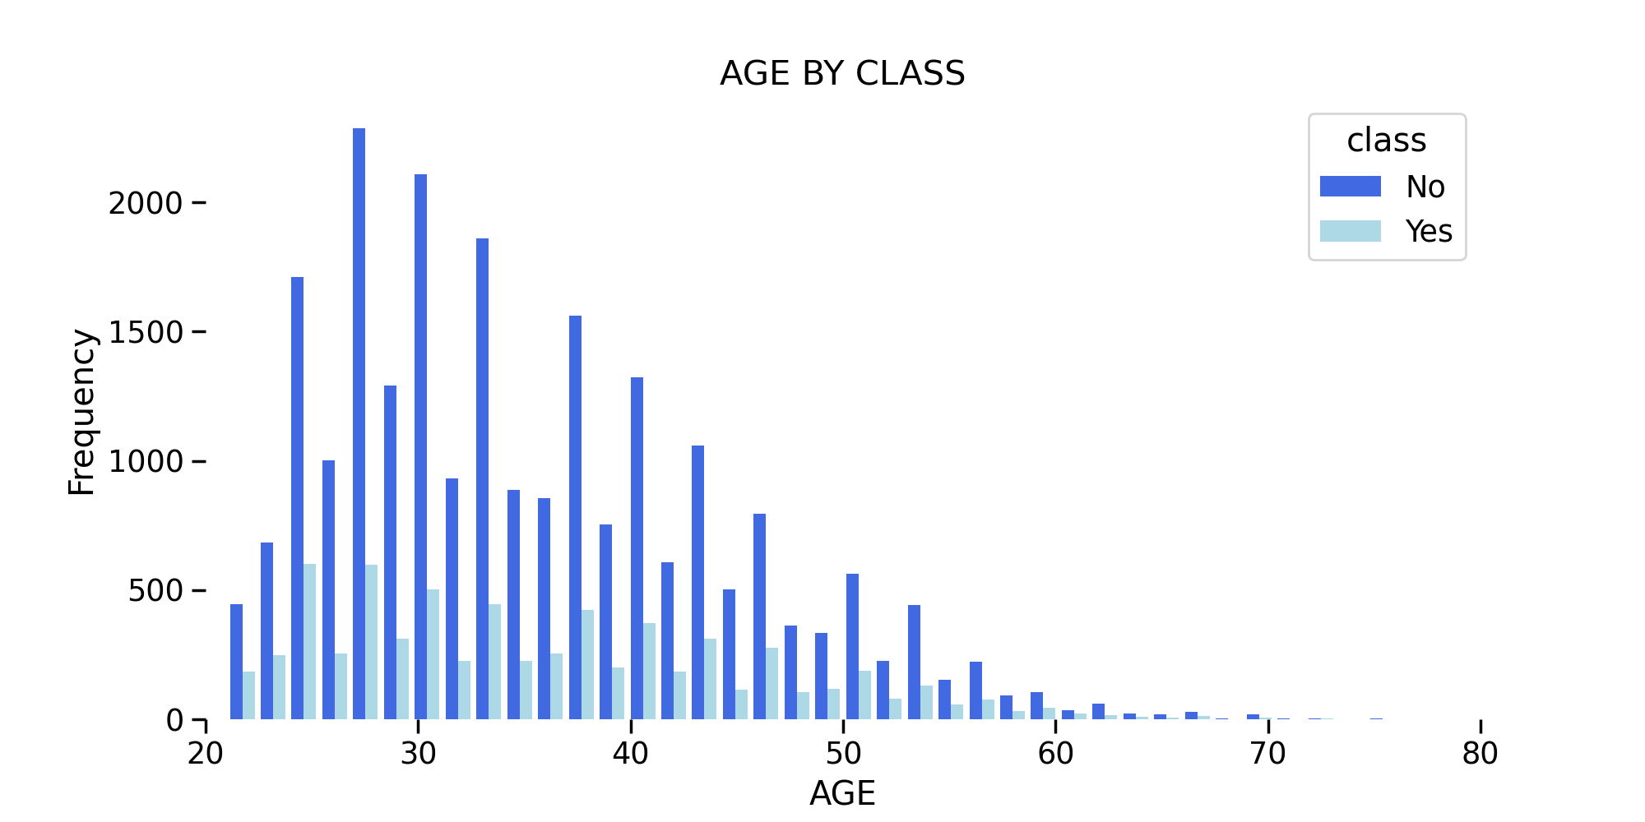
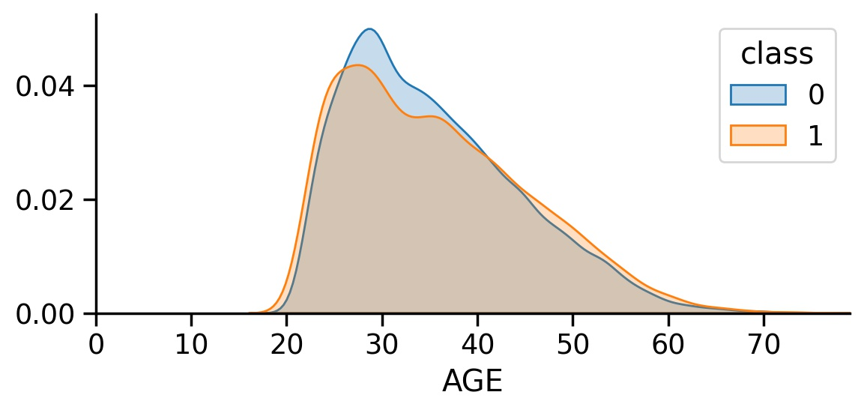
Relationship Between AGE & CLASS
Higher proportion of non – defaulters are in 25 to 40 years of age group.

Slide 7
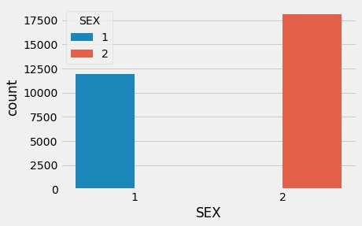
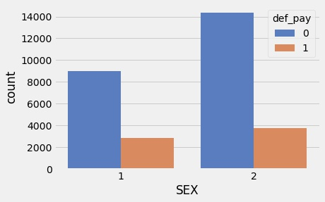
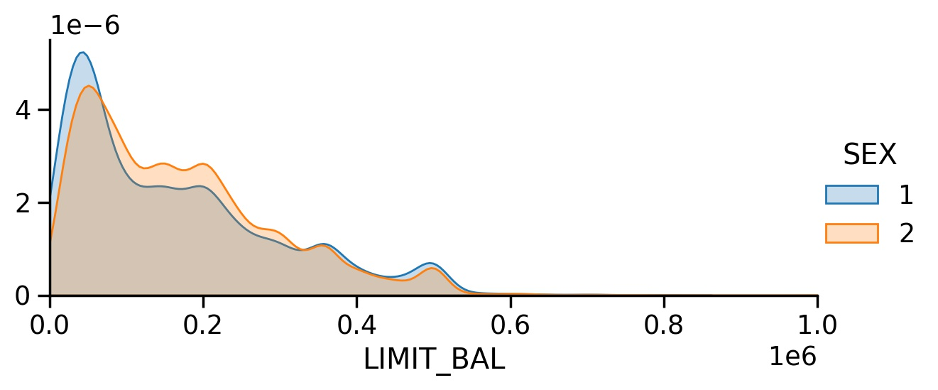
Effect of Gender, on Returning the Credit.
Higher proportion of female as compared to males
In both the classes (non defaulters and defaulters) proportion of females is more than males. Hence Females are more likely to default.
There are higher proportion of males with higher credit limit balance.

Slide 8
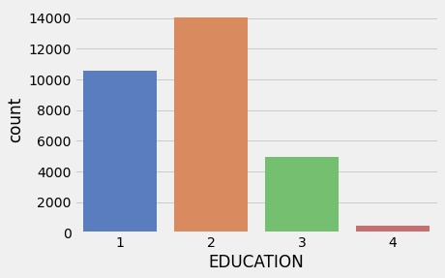
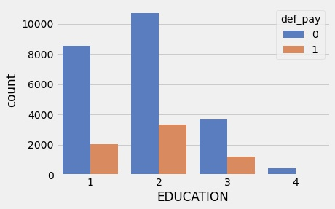
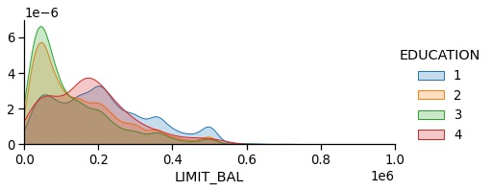
Effect of Education on Returning the Credit.
Highest proportion of people with university and graduate school education.
Higher proportion of non-defaulters to defaulters with university and graduate level education.

Slide 9
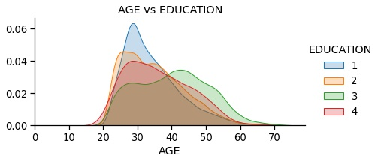
Relationship between Age and Education
Higher proportion of people with graduate and university level are in age group 20 to 40. While high school and other levels show lower proportion.

Slide 10
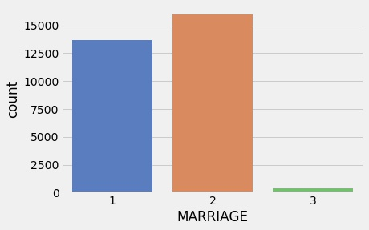
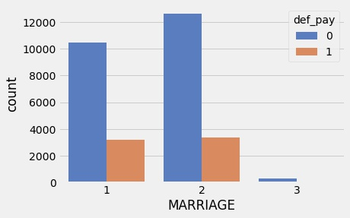
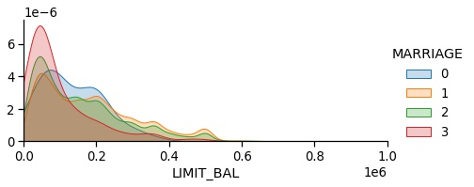
Effect of Marital Status, on Returning the Credit.
Higher proportion of people either married or single. Further proportion of singles is more than married.
For non-defaulters - singles and married in higher proportion. But in case of defaulters both singles and married show almost similar proportion.
Higher proportion of people with divorced marital status show lower df limit. While other statues show similar proportion.

Slide 11
Summary of Payment History

Slide 12
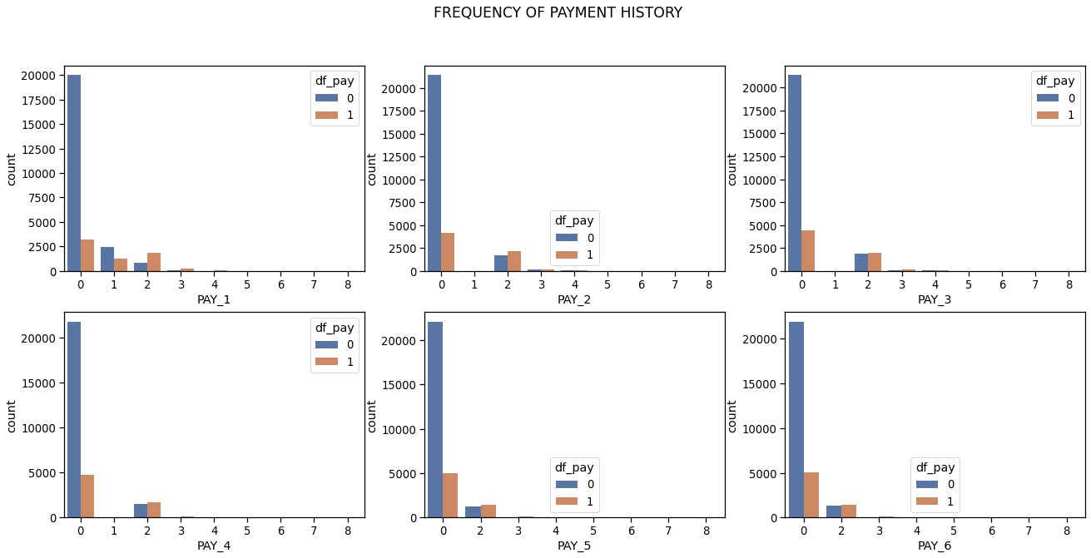

Slide 13
Summary of Bill Amount

Slide 14
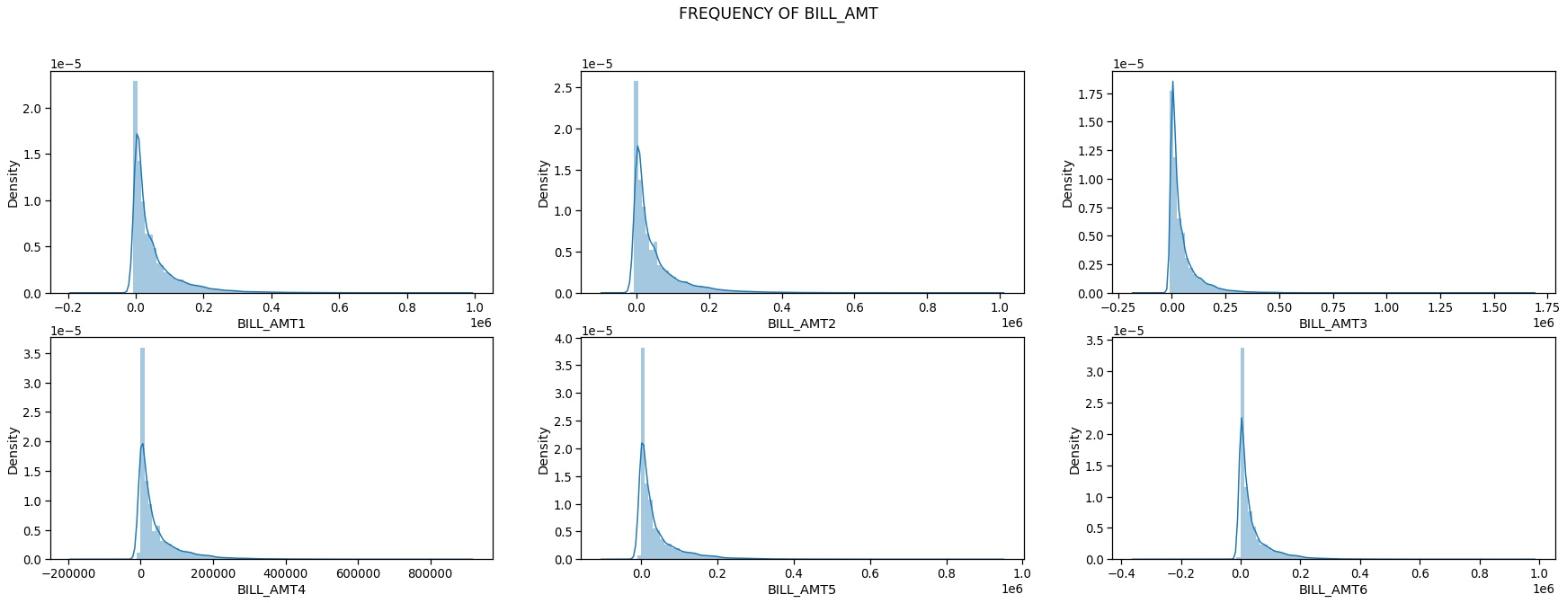

Slide 15
Summary of Payment Amount

Slide 16
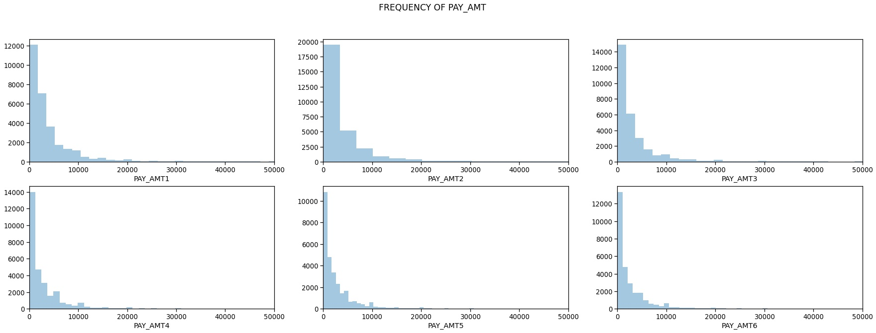

Slide 17
In all cases - people used revolving credit(category 0) followed by paid on time (category 1) and no consumption (category -2). This implies that people who make payments regularly or ahead of time are likely not to default next month.
While Maximum people found in billing amount ranging from 0 to $100,000.
Per billing amount maximum number of people paid previous payments ranging between 0 to $10000 in all cases.

Slide 18
THANK YOU

